Slide 1

8th Grade
Unit 12, Lesson 8 Evaluating Expressions Using the Order of Operations Volume 2, pg. 251

Slide 2


Benchmark
MA.8.NSO.1.7
Solve multi-step mathematical and real-world problems involving the order of operations with rational numbers, including exponents and radicals.
volume 2, pg. 251

Slide 3
Integrated Mathematical Thinking and Reasoning Standards
MA.K12.MTR.3.1 Complete tasks with mathematical fluency.
MA.K12.MTR.4.1 Engage in discussions that reflect on the mathematical thinking of self and others.
MA.K12.MTR.6.1 Assess the reasonableness of solutions.
volume 2, pg. 251

Slide 4

Learning Target
I can solve problems involving the order of operations with rational numbers, including exponents and radicals.
volume 2, pg. 251

Slide 5

Warm-Up
volume 2, pg. 252

Slide 6
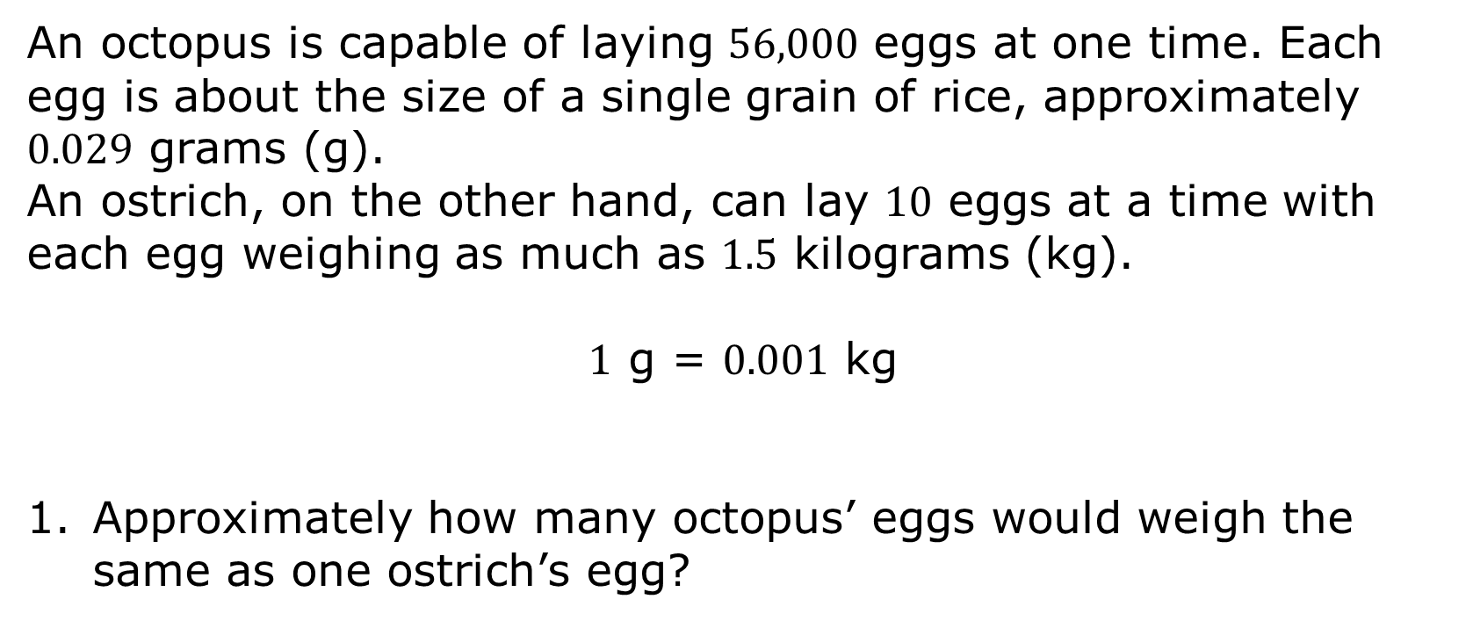
12.8.1 Warm-Up: Between Two Numbers
An octopus is capable of laying $56,000$ eggs at one time. Each egg is about the size of a single grain of rice, approximately $0.029$ grams (g).
An ostrich, on the other hand, can lay $10$ eggs at a time with each egg weighing as much as $1.5$ kilograms (kg).
$1$ g = $0.001$ kg
Approximately how many octopus’ eggs would weigh the same as one ostrich’s egg?
volume 2, pg. 252

Slide 7

Guided Practice
volume 2, pg. 252

Slide 8


12.8.2 Guided Practice: Evaluating Expressions
Find the value of each expression. Show your work.
${\left(\frac{1}{2}∙4\right)}^{−3}−\frac{3}{4}∙12$
$\sqrt[3]{−125}−3∙5^{2}+{\left(\frac{1}{8}\right)}^{−1}$
volume 2, pg. 252

Slide 9
$z∙\sqrt{21z+\left(6^{2}−1\right)}$, where $z=\frac{2}{3}$
volume 2, pg. 252

Slide 10

Collaboration
volume 2, pg. 253

Slide 11

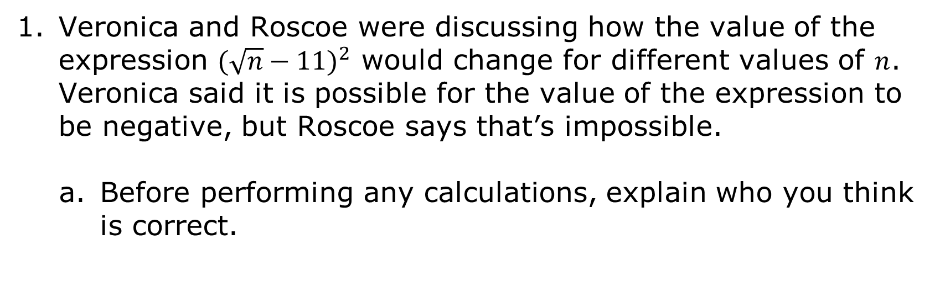
12.8.3 Collaboration: Analyzing Student Work
Veronica and Roscoe were discussing how the value of the expression ${(\sqrt{n}−11)}^{2}$ would change for different values of $n$. Veronica said it is possible for the value of the expression to be negative, but Roscoe says that’s impossible.
Before performing any calculations, explain who you think is correct.
volume 2, pg. 253

Slide 12
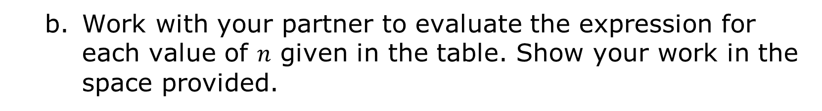
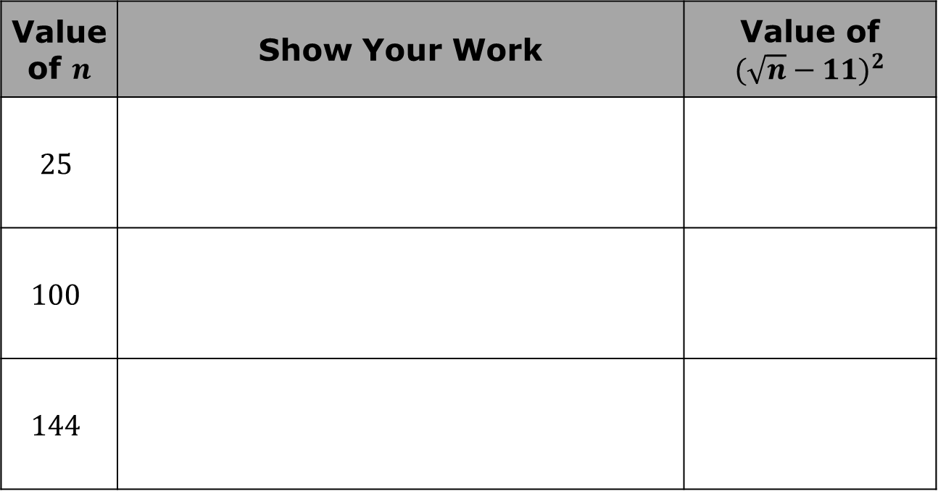
Work with your partner to evaluate the expression for each value of $n$ given in the table. Show your work in the space provided.
Value of $n$ | Show Your Work | Value of ${(\sqrt{n}−11)}^{2}$
$$25$$
$$100$$
$$144$$
volume 2, pg. 253

Slide 13
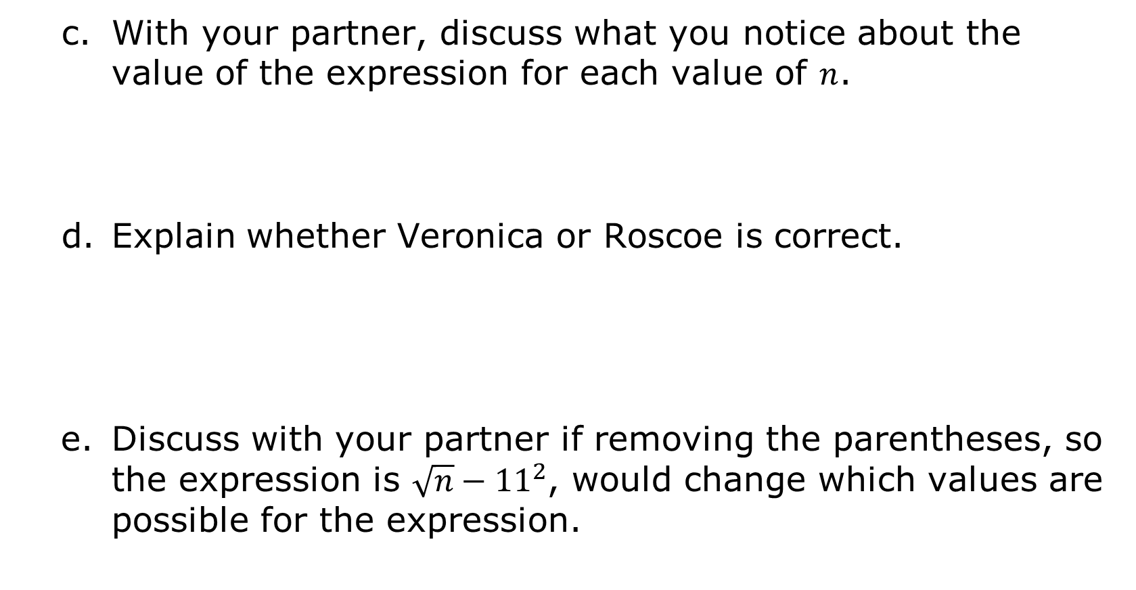
With your partner, discuss what you notice about the value of the expression for each value of $n$.
Explain whether Veronica or Roscoe is correct.
Discuss with your partner if removing the parentheses, so the expression is $\sqrt{n}−{11}^{2}$, would change which values are possible for the expression.
volume 2, pg. 253

Slide 14

Work with your partner to complete the following.
Liesel evaluated the expression $\frac{{\left(−11 + 2^{3}\right)}^{2}}{\sqrt{4^{3}}} − \frac{1}{4}$. Her work is shown, beginning with the original expression.
$\frac{{\left(−11 + 2^{3}\right)}^{2}}{\sqrt{4^{3}}} − \frac{1}{4}$
$\frac{{\left(−11 + 8\right)}^{2}}{\sqrt{4^{3}}} − \frac{1}{4}$
$\frac{{\left(−3\right)}^{2}}{\sqrt{4^{3}}} − \frac{1}{4}$
$\frac{−9}{\sqrt{4^{3}}} − \frac{1}{4}$
$\frac{−9}{4} − \frac{1}{4}$
$−\frac{10}{4}$
$$−2.5$$
volume 2, pg. 254

Slide 15
Liesel made errors when evaluating the expression.
Circle where Liesel made errors.
Correct her work in the space provided beside Liesel’s work.
Write Liesel a short note with advice on how to avoid similar mistakes in the future.
volume 2, pg. 254

Slide 16
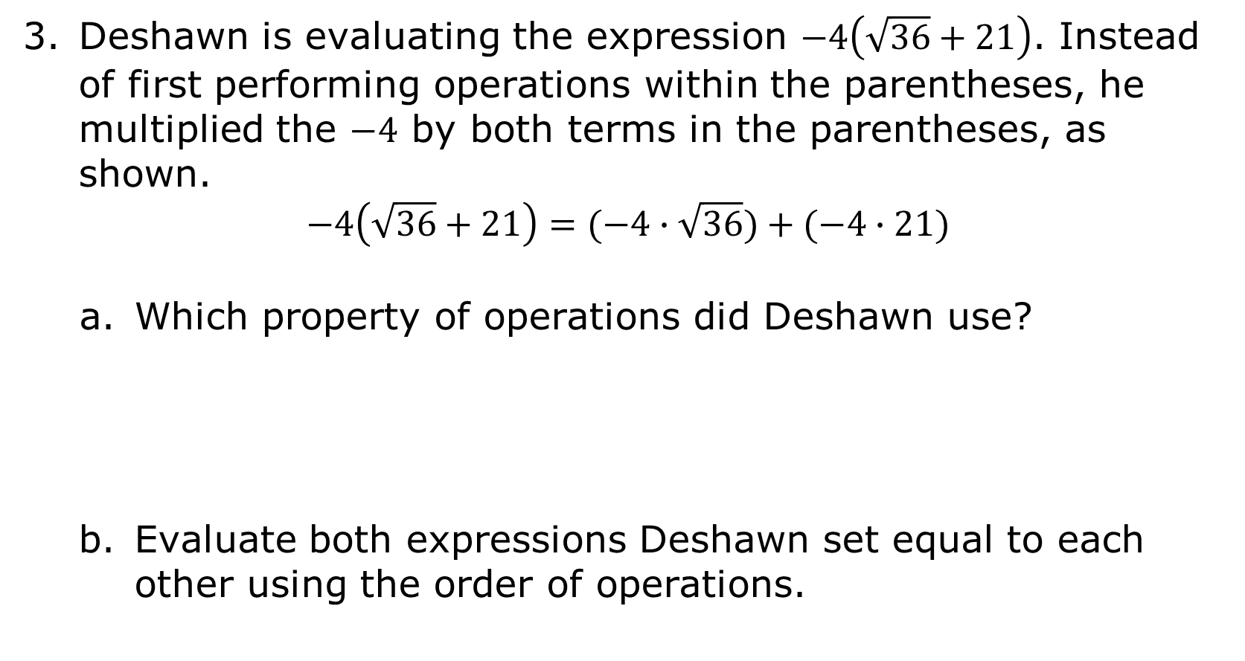
Deshawn is evaluating the expression $−4\left(\sqrt{36}+21\right)$. Instead of first performing operations within the parentheses, he multiplied the $−4$ by both terms in the parentheses, as shown.
$$−4\left(\sqrt{36}+21\right)=(−4∙\sqrt{36})+(−4∙21)$$
Which property of operations did Deshawn use?
Evaluate both expressions Deshawn set equal to each other using the order of operations.
volume 2, pg. 254

Slide 17
Explain how the values of the two expressions compare.
volume 2, pg. 254

Slide 18

Try It
volume 2, pg. 255

Slide 19

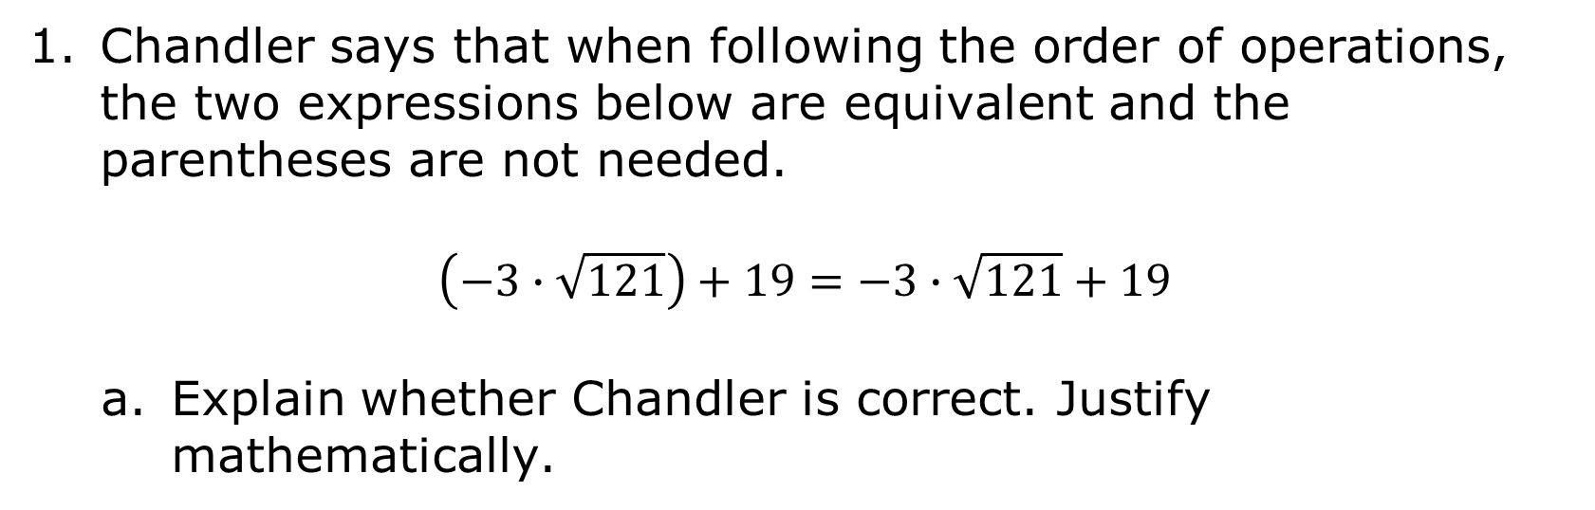
12.8.4 Try It: The Impact of Grouping
Chandler says that when following the order of operations, the two expressions below are equivalent and the parentheses are not needed.
$$\left(−3∙\sqrt{121}\right)+19=−3∙\sqrt{121}+19$$
Explain whether Chandler is correct. Justify mathematically.
volume 2, pg. 255

Slide 20
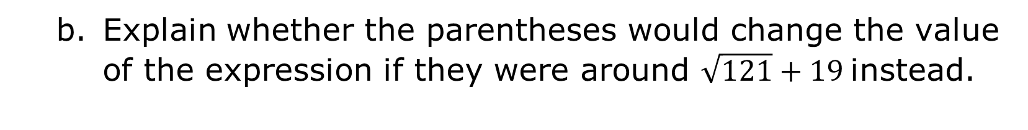
Explain whether the parentheses would change the value of the expression if they were around $\sqrt{121}+19$ instead.
volume 2, pg. 255

Slide 21
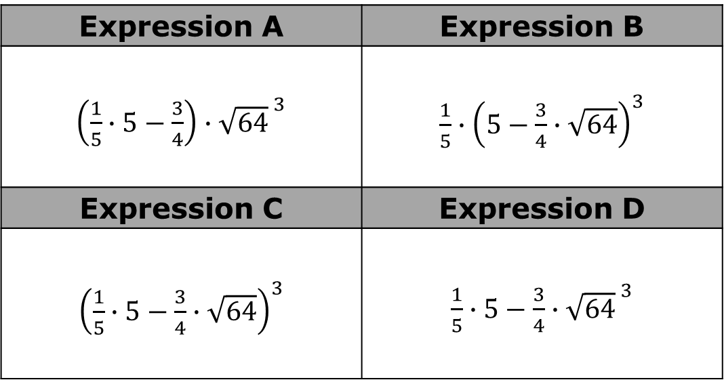
Four expressions are shown. One does not include any grouping symbols, while the others have parentheses placed around different parts of the expression.
Expression A | Expression B
$\left(\frac{1}{5}∙5−\frac{3}{4}\right)∙{\sqrt{64}}^{ 3}$ | $\frac{1}{5}∙{\left(5−\frac{3}{4}∙\sqrt{64}\right)}^{3}$
Expression C | Expression D
${\left(\frac{1}{5}∙5−\frac{3}{4}∙\sqrt{64}\right)}^{3}$ | $\frac{1}{5}∙5−\frac{3}{4}∙{\sqrt{64}}^{ 3}$
volume 2, pg. 255

Slide 22
Work with your partner to evaluate each expression. Show your work in the space provided.
Discuss with your partner how the placement of parentheses can impact the value of an expression.
Expression | Value
A
B
C
D
volume 2, pg. 255

Slide 23

When the placement of grouping symbols changes the order in which the operations are performed, the value of the expression changes.
volume 2, pg. 255

Slide 24

Wrap-Up
volume 2, pg. 256

Slide 25
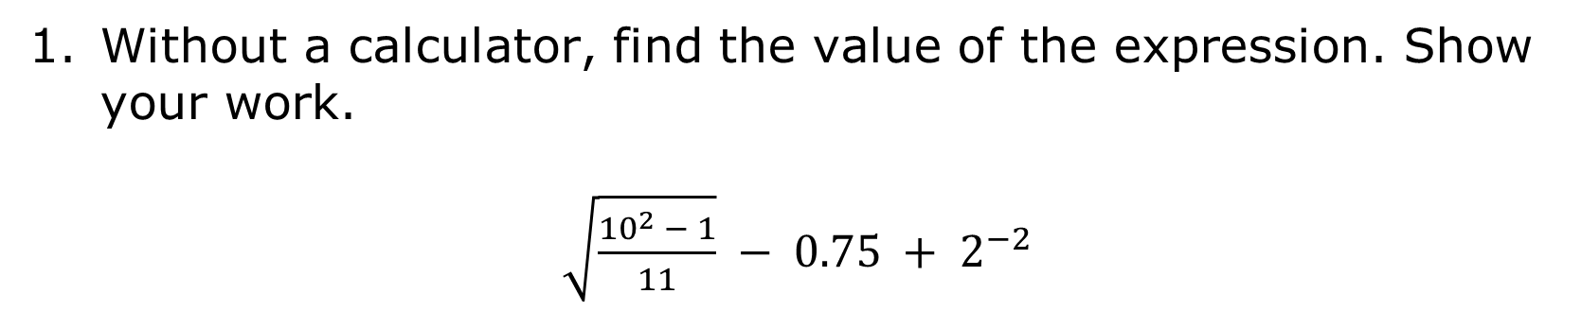
12.8.5 Wrap-Up: Ticket Out the Door
Without a calculator, find the value of the expression. Show your work.
$\sqrt{\frac{{10}^{2} − 1}{11}} − 0.75 + 2^{−2}$
volume 2, pg. 256

